Slide 1

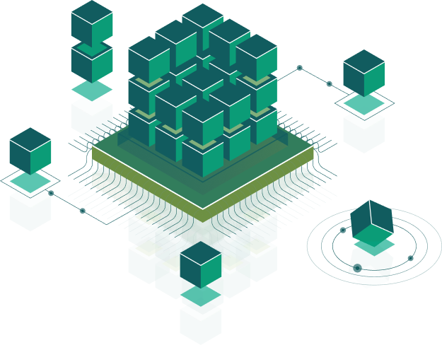
Architectural patterns: MVC, MVP, MVVM
Speaker:
Andrii Rudyk

Slide 2

Design Patterns
Design patterns are typical solutions to commonly occurring problems in software design. They are like pre-made blueprints that you can customise to solve a recurring design problem in your code. Patterns are often confused with algorithms, because both concepts describe typical solutions to some known problems. While an algorithm always defines a clear set of actions that can achieve some goal, a pattern is a more high-level description of a solution.

Slide 3
Types of Design Patterns
Creational patterns - deals with object creation mechanisms, trying to create objects in a manner suitable to the situation. (Builder, Factory, Prototype, ect.)
Structural patterns - shows us how to glue different pieces of a system together in a flexible and extensible fashion (Adapter, Bridge, Facade)
Behavioral patterns - identifies common communication patterns among objects and realize these patterns. By doing so, these patterns increase flexibility in carrying out this communication (Observer, Iterator, Strategy)

Slide 4
Benefits of Design Patterns
Saves time - provides industry standard approach to solve a recurring problem, so it saves time if we sensibly use the design pattern.
Reusability and Robustness - using design patterns promotes reusability that leads to more robust and highly maintainable code.
Easy to understand and easy to debug
Extensible - huge code will be modularised and easy to extend the code

Slide 5
Architectural Design Patterns
An architectural pattern is a general, reusable solution to a commonly occurring problem in software architecture within a given context. Architectural patterns are similar to software design pattern but have a broader scope. There are several types of architectural patterns:
MVC (Model View Controller)
MVP (Model View Presenter)
MVVM (Model View ViewModel)

Slide 6
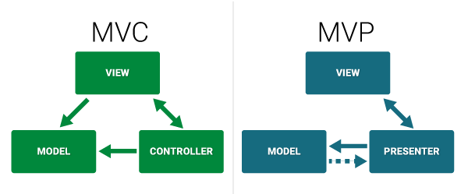
Model View Controller
Model - contains models of business logic, i.e. the classes that will model the solution for the problem and objective of the application
View - your visual classes. Everything the user sees falls under this category
Controller - updates the view, takes user input, and makes changes to the model

Slide 7
Model View Presenter
Model - contains models of business logic, i.e. the classes that will model the solution for the problem and objective of the application
View - your visual classes. Everything the user sees falls under this category
Presenter - updates the view, takes user input, and makes changes to the model

Slide 8
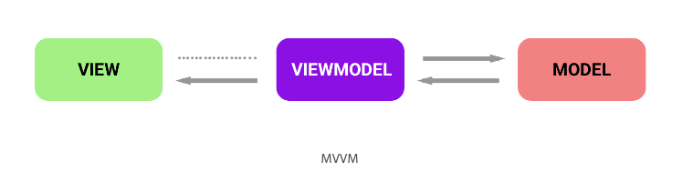
Model View ViewModel
This is similar to the MVC pattern; the Model and View components are the same. The ViewModel object is the “glue” between the model and view layers, but operates differently than the Controller component. Instead, it exposes commands for the view and binds the view to the model. When the model updates, the corresponding views update as well via the data binding.

Slide 9
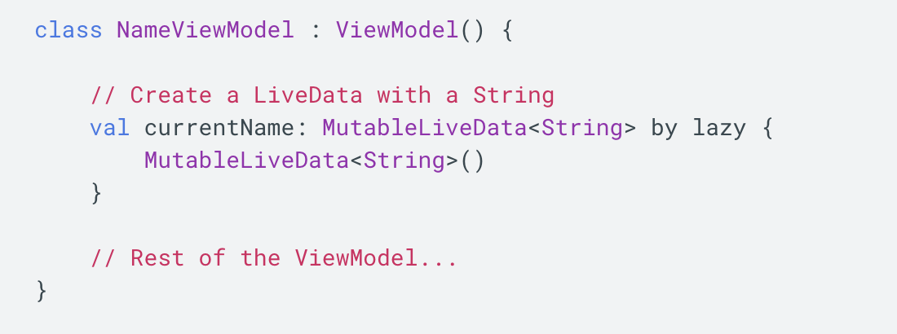
LiveData
LiveData is an observable data holder class. Unlike a regular observable, LiveData is lifecycle-aware, meaning it respects the lifecycle of other app components, such as activities, fragments, or services. The advantages of using LiveData:
Ensures your UI matches your data state
No memory leaks
No crashes due to stopped activities
No more manual lifecycle handling
Always up to date data
Proper configuration changes
Sharing resources

Slide 10
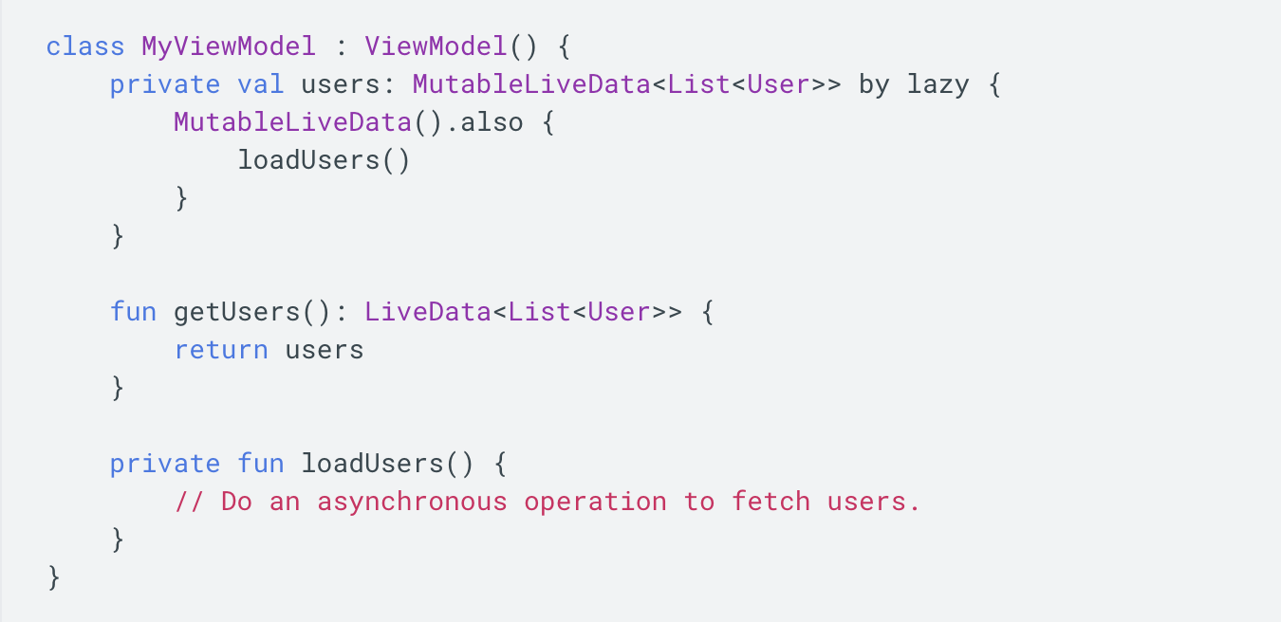
Android ViewModel
The Android framework manages the lifecycles of UI controllers, such as activities and fragments. The framework may decide to destroy or re-create a UI controller in response to certain user actions or device events that are completely out of your control.

Slide 11

Thank you!

